Slide 1
Challenges and Opportunities for Research on Optical Distinctiveness: Evidence from the Italian Opera Industry
Gino Cattani
Stern (NYU)
AOM August 1st 2021

Slide 2
The Opera Industry
The operatic world is the epitome of a context that shows custodial responsibility to the past and the future (Soares 1997)
Italian opera houses have been especially wary of preserving this revered art form by populating their programs with traditional pre-20th century operas
E.g., Giuseppe Verdi’s La Traviata or Giacomo Puccini’s La Tosca, which have come to define operas for many audiences (Gossett 2008)
However, opera houses strongly aspire to innovation and artistic originality

Slide 3
Renewing by Reinterpreting Tradition
One of the main approaches through which opera houses seek to pursue artistic renewal is by reinterpreting traditional works in novel ways
This kind of innovation does not usually alter the opera as a musical form; rather, it implies restaging and redesigning traditional material in an effort to actualize its meaning
Martorella 1975; Snowman 2009

Slide 4
Two Types of Reinterpretations
Robust reinterpretations change the more peripheral aspects (visual staging) of an opera, but preserve its core aspects (music and dramatic content)
Radical reinterpretations modify the very essence of traditional operas by manipulating their core features

Slide 5
Traditional, Robust and Radical Reinterpretations (%)

Slide 6
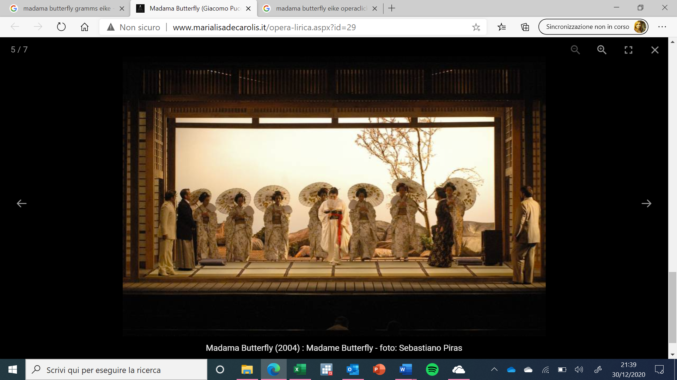
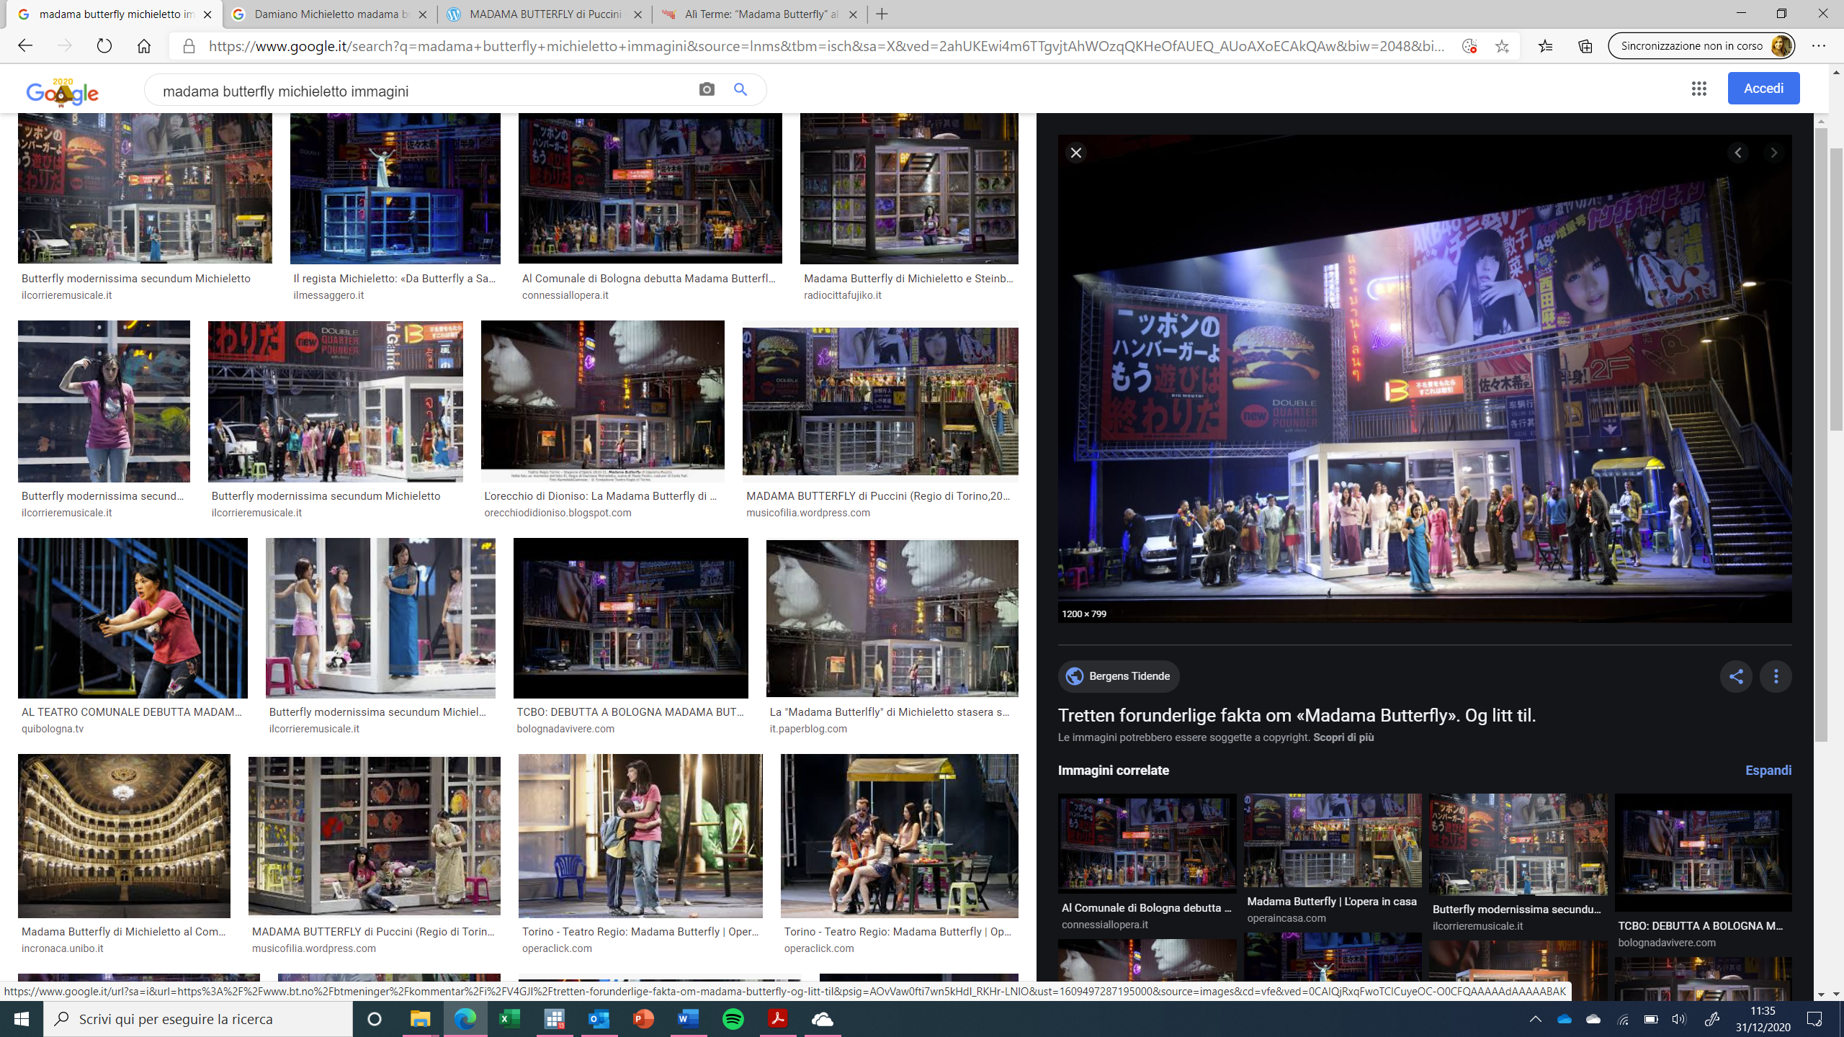
Madama Butterfly (Giacomo Puccini)
Original Version
Robust Reinterpretation
Stage director: Eike Gramss
Stage director: Damiano Michieletto

Slide 7
Review
“Director Damiano Michieletto has conceptually updated the story of Cio Cio San [...] The scene opens on the chaotic street of an evolved East Asian city: bright and colorful writings in English, Chinese and Thai form the background to the home of Butterfly, a place of love and a place of suicide […] The story is modernized but the direction respects the music and follows the text (libretto) with precision and in a substantially didactic way, without excessive forcing and focusing on a clear characterization of the characters and their peculiar traits: the vulgarity of Pinkerton, the naive fragility of Butterfly [...]” (OperaClick, 2012)

Slide 8
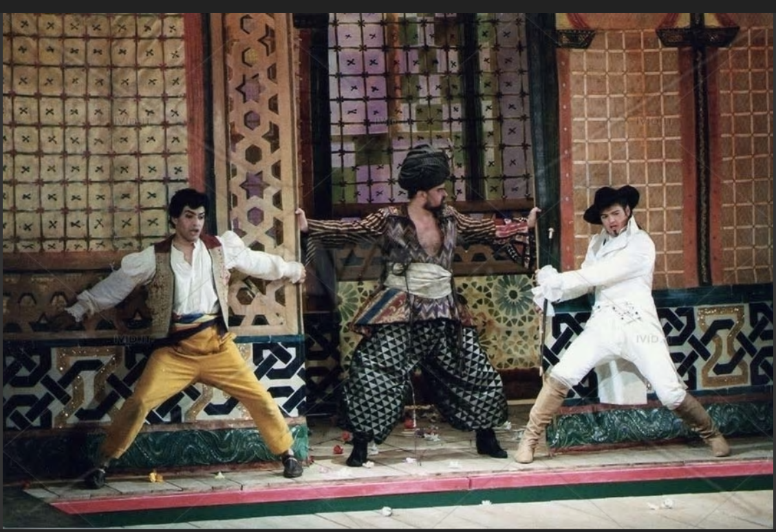
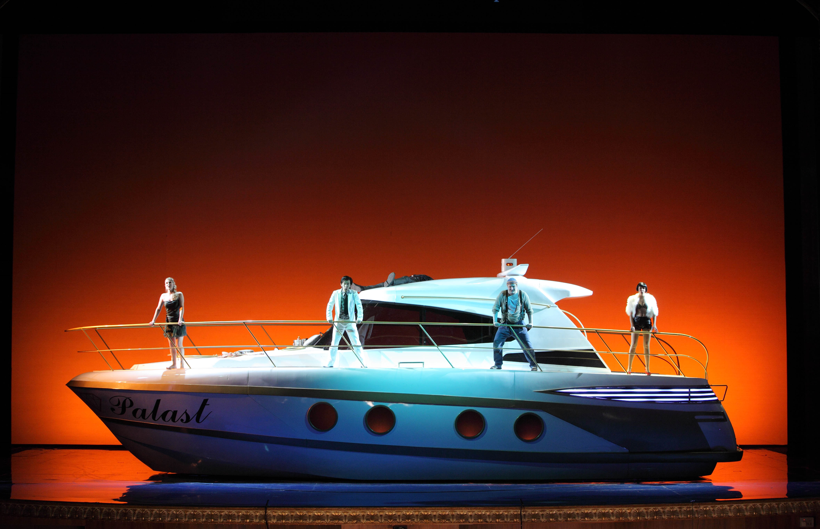
Il Ratto del Serraglio (Wolfgang Amadeus Mozart)
Original Version
Radical Reinterpretation
Stage director: Eike Gramss
Stage director: Damiano Michieletto

Slide 9
Review
“The young and already acclaimed director, free of reverential fears, enjoys updating the work of Mozart, bringing it down to a realistic, deliberately vulgar and irreverent dimension […] the connection with Mozart’s original work is reduced to a minimum: there is no longer any trace of the “oriental” color; the fabulous dimension of the work, with all its load of dreams, games and melancholy; even the text, despite the adjustments made, is often incongruent with respect to what we see […]” (Il Giornale della Musica, 2009)

Slide 10
Expectations
Robust reinterpretation of the tradition should appeal more to audience members
Radical reinterpretations of the tradition should appeal less to audience members

Slide 11
Determinants of Ticket Sales (Mixed Effect Linear Regression)
 | Dependent Variable: Ticket Sales (log)
 | Model 1 | Model 2 | Model 3 | Model 4 | Model 5
Robust reinterpretation | 0.055 |  | 0.074 |  | 0.087
 | (0.004) |  | (0.001) |  | (0.000)
Radical reintepretation |  | 0.143 | 0.169 |  | 0.131
 |  | (0.008) | (0.003) |  | (0.001)
Controls | no | no | no | Included | Included
Time Dummies | Included | Included | Included | Included | Included
_cons | 7.869 | 7.877 | 7.867 | 7.436 | 7.422
 | (0.000) | (0.000) | (0.000) | (0.000) | (0.000)
Log PseudoLikelihood | -2079.5696 | -2076.3992 | -2071.52 | -1810.4328 | -1799.2782
P values in parenthesis. Traditional reinterpretations are the comparison category. Number of observations 2,627. Standard Errors are heteroskedastic-consistent (“robust”)

Slide 12
Season- vs. Single-Ticket Holders
Opera goers vary in their degree of operatic connoisseurship, which affects their response to different manipulations of the operatic tradition
This variability maps onto two distinct segments
Season-ticket holders – who are customers with a greater and longer-term commitment to the operatic world and a higher level of expertise
Single-ticket holders – who are usually one-time customers with no or limited expertise and a lower commitment to the operatic experience

Slide 13
Determinants of Seasonal Ticket Sales (Mixed Effect Linear Regression)
 | Dependent Variable: Seasonal Ticket Sales (log)
 | Model 6 | Model 7 | Model 8 | Model 9 | Model 10
Robust reinterpretation | 0.181 |  | 0.180 |  | 0.195
 | (0.000) |  | (0.000) |  | (0.000)
Radical reintepretation |  | -0.078 | -0.011 |  | -0.031
 |  | (0.093) | (0.830) |  | (0.574)
Controls | no | no | no | Included | Included
Time Dummies | Included | Included | Included | Included | Included
_cons | 6.929 | 6.960 | 6.930 | 6.514 | 6.475
 | (0.000) | (0.000) | (0.000) | (0.000) | (0.000)
Log PseudoLikelihood | -2436.606 | -2454.4882 | -2436.585 | -2368.4551 | -2344.6513
P values in parenthesis. Traditional reinterpretations are the comparison category. Number of observations 2,459. Standard Errors are heteroskedastic-consistent (“robust”)

Slide 14
Determinants of Single Ticket Sales (Mixed Effect Linear Regression)
 | Dependent Variable: Single Ticket Sales (log)
 | Model 11 | Model 12 | Model 13 | Model 14 | Model 15
Robust reinterpretation | -0.080 |  | -0.057 |  | -0.042
 | (0.007) |  | (0.071) |  | (0.090)
Radical reintepretation |  | 0.230 | 0.209 |  | 0.162
 |  | (0.001) | (0.002) |  | (0.001)
Controls | no | no | no | Included | Included
Time Dummies | Included | Included | Included | Included | Included
_cons | 7.250 | 7.239 | 7.247 | 6.813 | 6.823
 | (0.000) | (0.000) | (0.000) | (0.000) | (0.000)
Log PseudoLikelihood | -2701.5112 | -2695.6664 | -2693.9057 | -2466.0235 | -2458.4711
P values in parenthesis. Traditional reinterpretations are the comparison category. Number of observations 2,623. Standard Errors are heteroskedastic-consistent (“robust”)

Slide 15
Discussion
Audiences differ in their disposition towards novelty and conformity
Wijnberg 1995; Pontikes 2012; Paolella and Durand 2013; Cattani et al. 2014, 2017; Ertug 2016; Goldberg et al. 2016
The level of heterogeneity in evaluative schemas can vary significantly across
Different audiences
E.g., critics and customers (Kim and Jensen 2011), critics and peers (Cattani et al. 2014)
Different segments of the same audience
Any given audience is “never fully homogenous but usually consists of groups or segments that can embrace rather different standards and norms by which novelty is evaluated” (Cattani et al. 2020: 21)

Slide 16
Discussion … (cont’d)
Research on optimal distinctiveness argues that firms seek to resolve the tension between conformity and differentiation by adopting a moderate level of novelty for their products
E.g., Deephouse 1999; Lounsbury and Glynn 2001; Brewer 1991; Durand et al. 2007; Zhao et al. 2013; Zhao et al. 2017
However, a moderate level of novelty is not always an effective strategy and firms should
Recognize the existence of different segments even within the same audience type
Deploy strategies that vary in their degree of novelty based on the target audience(s)

Slide 17
Thanks!

